Slide 1
CSE408 Count, Radix & Bucket Sort
Lecture #17

Slide 2
How Fast Can We Sort?
Selection Sort, Bubble Sort, Insertion Sort:
Heap Sort, Merge sort:
Quicksort:
What is common to all these algorithms?
Make comparisons between input elements
a_{i} < a_{j}, a_{i} ≤ a_{j}, a_{i} = a_{j}, a_{i} ≥ a_{j}, or a_{i} > a_{j}
O(n²)
O(nlgn)
O(nlgn) - average

Slide 3
Lower-Bound for Sorting
Theorem: To sort n elements, comparison sorts must make Ω(nlgn) comparisons in the worst case.
(see CS477 for a proof)

Slide 4
Can we do better?
Linear sorting algorithms
Counting Sort
Radix Sort
Bucket sort
Make certain assumptions about the data
Linear sorts are NOT “comparison sorts”

Slide 5
Counting Sort
Assumptions:
n integers which are in the range [0 ... r]
r is in the order of n, that is, r=O(n)
Idea:
For each element x, find the number of elements x
Place x into its correct position in the output array
output array

Slide 6
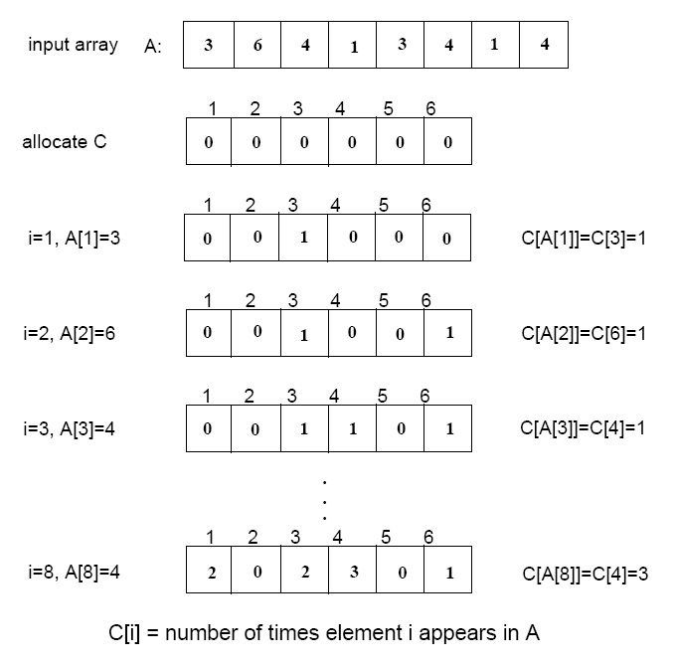

Step 1
(i.e., frequencies)
(r=6)

Slide 7
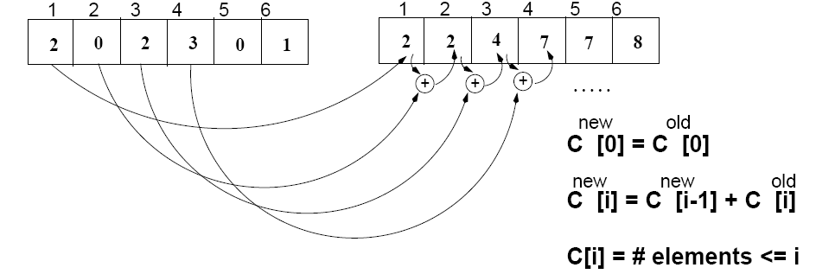
Step 2
C
(frequencies)
C^{new}
(cumulative sums)

Slide 8
Algorithm
Start from the last element of A
Place A[i] at its correct place in the output array
Decrease C[A[i]] by one
1
2
3
4
5
6
7
8
A
2
5
3
0
2
3
0
3
0
1
2
3
4
5
C^{new}
2
2
4
7
7
8

Slide 9
Example
1
2
3
4
5
6
7
8
0
1
2
3
4
5
A
2
5
3
0
2
3
0
3
C^{new}
2
2
4
7
7
8
1
2
3
4
5
6
7
8
1
2
3
4
5
6
7
8
B
3
B
0
3
0
1
2
3
4
5
0
1
2
3
4
5
C^{new}
C^{new}
1
2
4
6
7
8
2
2
4
6
7
8
1
2
3
4
5
6
7
8
1
2
3
4
5
6
7
8
B
0
3
3
B
0
2
3
3
0
1
2
3
4
5
0
1
2
3
4
5
C^{new}
C^{new}
1
2
3
5
7
8
1
2
4
5
7
8

Slide 10
Example (cont.)
1
2
3
4
5
6
7
8
A
2
5
3
0
2
3
0
3
1
2
3
4
5
6
7
8
1
2
3
4
5
6
7
8
B
0
0
2
3
3
B
0
0
2
3
3
3
5
0
1
2
3
4
5
0
1
2
3
4
5
C
0
2
3
5
7
8
C
0
2
3
4
7
7
1
2
3
4
5
6
7
8
1
2
3
4
5
6
7
8
B
0
0
2
3
3
3
B
0
0
2
2
3
3
3
5
0
1
2
3
4
5
C
0
2
3
4
7
8

Slide 11
COUNTING-SORT
1
j
n
A
Alg.: COUNTING-SORT(A, B, n, k)
for i ← 0 to r
do C[ i ] ← 0
for j ← 1 to n
do C[A[ j ]] ← C[A[ j ]] + 1
C[i] contains the number of elements equal to i
for i ← 1 to r
do C[ i ] ← C[ i ] + C[i -1]
C[i] contains the number of elements ≤ i
for j ← n downto 1
do B[C[A[ j ]]] ← A[ j ]
C[A[ j ]] ← C[A[ j ]] - 1
0
k
C
1
n
B

Slide 12
Analysis of Counting Sort
Alg.: COUNTING-SORT(A, B, n, k)
for i ← 0 to r
do C[ i ] ← 0
for j ← 1 to n
do C[A[ j ]] ← C[A[ j ]] + 1
C[i] contains the number of elements equal to i
for i ← 1 to r
do C[ i ] ← C[ i ] + C[i -1]
C[i] contains the number of elements ≤ i
for j ← n downto 1
do B[C[A[ j ]]] ← A[ j ]
C[A[ j ]] ← C[A[ j ]] - 1
O(r)
O(n)
O(r)
O(n)
Overall time: O(n + r)

Slide 13
Analysis of Counting Sort
Overall time: O(n + r)
In practice we use COUNTING sort when r = O(n)
⇒ running time is O(n)

Slide 14
Radix Sort
Represents keys as d-digit numbers in some base-k
key = x₁x₂...x_{d} where 0≤x_{i}≤k-1
Example: key=15
key₁₀ = 15, d=2, k=10 where 0≤x_{i}≤9
key₂ = 1111, d=4, k=2 where 0≤x_{i}≤1

Slide 15
Radix Sort
Assumptions
d=O(1) and k =O(n)
Sorting looks at one column at a time
For a d digit number, sort the least significant digit first
Continue sorting on the next least significant digit, until all digits have been sorted
Requires only d passes through the list

Slide 16
RADIX-SORT
Alg.: RADIX-SORT(A, d)
for i ← 1 to d
do use a stable sort to sort array A on digit i
(stable sort: preserves order of identical elements)

Slide 17
Analysis of Radix Sort
Given n numbers of d digits each, where each digit may take up to k possible values, RADIX-SORT correctly sorts the numbers in O(d(n+k))
One pass of sorting per digit takes O(n+k) assuming that we use counting sort
There are d passes (for each digit)

Slide 18
Analysis of Radix Sort
Given n numbers of d digits each, where each digit may take up to k possible values, RADIX-SORT correctly sorts the numbers in O(d(n+k))
Assuming d=O(1) and k=O(n), running time is O(n)

Slide 19
Bucket Sort
Assumption:
the input is generated by a random process that distributes elements uniformly over [0, 1)
Idea:
Divide [0, 1) into k equal-sized buckets (k=Θ(n))
Distribute the n input values into the buckets
Sort each bucket (e.g., using quicksort)
Go through the buckets in order, listing elements in each one
Input: A[1 . . n], where 0 ≤ A[i] < 1 for all i
Output: elements A[i] sorted

Slide 20
Example - Bucket Sort
A
1
.78
.17
.39
.26
.72
.94
.21
.12
.23
.68
B
0
/
2
1
.17
.12 /
3
2
.26
.21
.23 /
4
3
.39 /
5
4
/
Distribute
Into buckets
6
5
/
7
6
.68 /
8
7
.78
.72 /
9
8
/
10
9
.94 /

Slide 21
Example - Bucket Sort
0
/
1
.12
.17 /
2
.21
.23
.26 /
3
.39 /
Sort within each
bucket
4
/
5
/
6
.68 /
7
.72
.78 /
8
/
9
.94 /

Slide 22
Example - Bucket Sort
.12
.17
.21
.23
.26
.39
.68
.72
.78
.94 /
0
/
1
.12
.17 /
2
.21
.23
.26 /
3
.39 /
4
/
5
/
Concatenate the lists from
0 to n – 1 together, in order
6
.68 /
7
.72
.78 /
8
/
9
.94 /

Slide 23
Analysis of Bucket Sort
Alg.: BUCKET-SORT(A, n)
for i ← 1 to n
do insert A[i] into list B[⎣nA[i]⎦]
for i ← 0 to k - 1
do sort list B[i] with quicksort sort
concatenate lists B[0], B[1], . . . , B[n -1] together in order
return the concatenated lists
O(n)
k O(n/k log(n/k))
=O(nlog(n/k)
O(k)
O(n) (if k=Θ(n))

Slide 24
Radix Sort as a Bucket Sort

